Slide 1
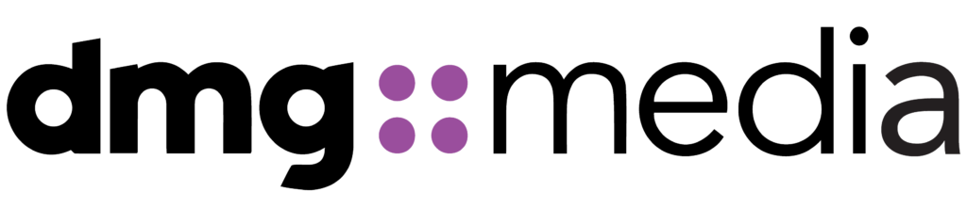
Cloud Readiness Assessment – Part 1
Platform Direction & Path Forward
April 2026
Scott Beckford
Senior Consulting Cloud Architect

Slide 2
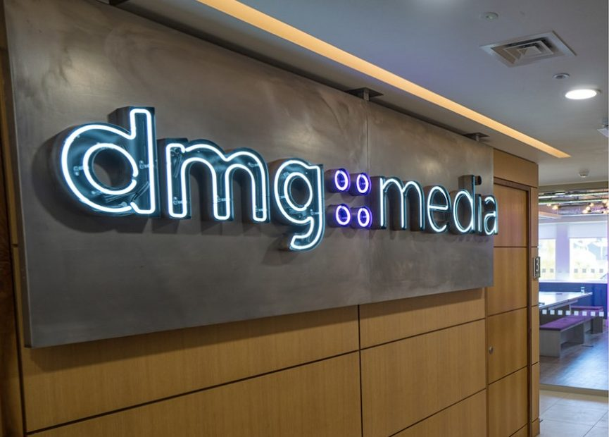
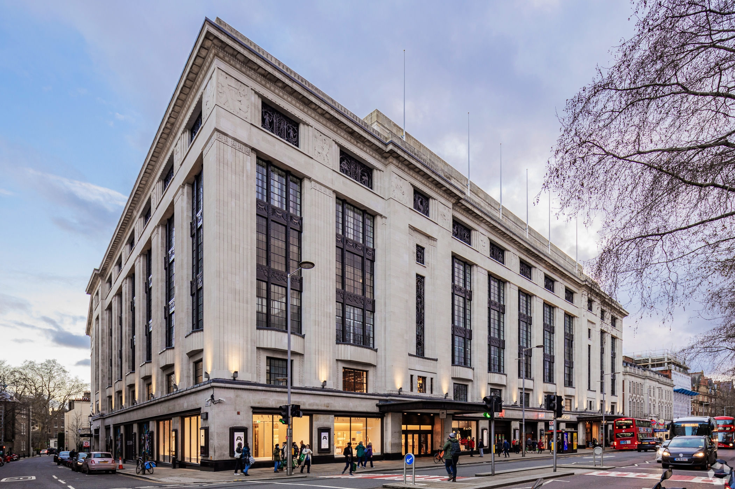
# | Agenda Item | Detail | Duration
1 | Executive Summary | Key findings Scope and recommendation up front | 15 min
2 | Why Cloud? Why Now? | Business drivers and case for acting now | 30 min
3 | Your Estate | Discovery applications databases Workshops and gaps | 30 min
4 | Cost Comparison | Methodology comparison Oracle paths and Complete View | 30 min
5 | BREAK |  | 15 min
6 | Business & Application Fit | Technical constraints cohorts and co-migration groups | 15 min
7 | Hyperscaler Recommendation | Scoring Why AWS platform comparison and decision discussion | 30 min
8 | Customer Readiness | Readiness scores and closing the gap | 10 min
9 | Challenges & Opportunities | Paired challenges and quantified and strategic opportunities | 15 min
10 | Moving Forward and Part 2 | Decisions needed Part 2 scope timeline and hyperscaler guidance | 20 min
11 | Working Discussion | Agree platform direction Oracle path and Part 2 go/no-go | 30 min

Slide 3
Executive Summary

Slide 4
Our Understanding of DMG
See fedex slide
Define opportunity

Slide 5

What this assessment covers
What this assessment does
Provides an evidence‑based view of cloud suitability for the in‑scope estate
Cloud Agnostic comparison of AWS, Azure, and GCP using the same source data
Identifies material technical constraints, cost drivers, and readiness gaps
Reaches a primary platform recommendation
What this assessment deliberately does not do
Estimate migration execution cost or a Year‑1 financial outcome
Produce a final application‑by‑application migration plan
Design a landing zone or target security architecture
Define a long‑term Oracle strategy
Why those boundaries matter
These boundaries let us give you a clear platform direction today without forcing design, cost, or database decisions that belong in later phases.
Detailed sequencing, design, and planning follow once general strategic platform direction is agreed.
Notes:
The brief you gave us was to help with 2 key strategic goals:
1. to help analyse your estate and prepare a business aligned strategic report on:
Business strategy
TCO analysis
Hyperscaler Selection
DMG Cloud Readiness
2. Negotiate on behalf of DMG with the Hyperscalers to prepare their initial offers, discounts, and benefits to enable DMG to quickly make a decision on which key partner to choose and move forward with how to proceed with their digital transformation strategy.
A hybrid environment was not factored in because Reduced Hyperscaler funding
Operations Costs – effectively managing 2 clouds is double the work
Security doesn’t scale

Slide 6

Scope Summary
11‑week independent Cloud Readiness Assessment
3 datacentres Reading, Slough, Sydney
3,038 servers discovered and independently priced
39 applications profiled across 9 workshops
88 databases Oracle and SQL Server assessed
3 clouds compared using live pricing APIs
5 infrastructure types VMware, Proxmox, physical, appliance, cloud
Notes:
3038 servers
14,165 vCPUs
54 TB Memory
1.2 Pb storage

Slide 7
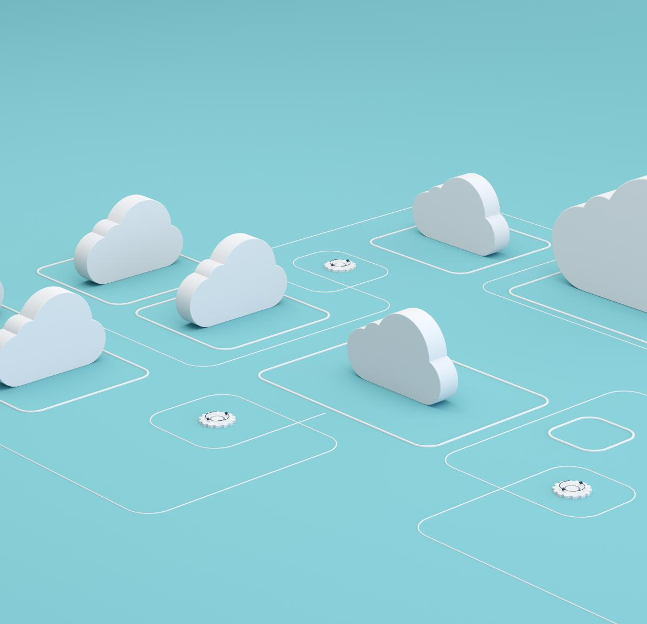
Key Findings – Risks and Opportunities
Opportunity to align technology spend against utilisation (OpEx Model)
Existing systems out of vendor support
Opportunity to bring unsupported/legacy applications into support
Legacy technologies limit rapid innovation
Licensing expected to significant increase with renewals in 2027 (Eg, VMWare)
Introduce technical standardisation and common architecture patterns
Current scalability approaches are vertical (no horizontal scaling)
Cloud Aligned Operating Model + Opportunity to upskill staff on cloud technologies
Doing nothing is no longer a safe or cheap option
Datacentre leases, VMware licensing changes, and the Microsoft EA all come up for renewal within the next two years. If decisions are delayed, you will end up making commitments to legacy technology through renewals rather than by choice.
Technology needs to evolve to allow DMG to innovate
<Add text here>
Target Operating Model Alignment
Cloud migration provides a one-time opportunity for standardisation across brands, elimination of silos and reduction in shadow IT
DMG environment. Is complex
The evidence points to a clear primary cloud direction
All 3 Hyperscalers could do the job, results were very close, however, when cost, technical constraints, and operating realities are considered together:
AWS is the platform that best fits the estate and DMG’s business drivers
GCP is retained where it already delivers clear business value for DMG
Azure carries a material cost premium without a matching benefit
Oracle is a major complexity, but not a blocker to deciding the platform
Oracle behaves broadly the same across all three clouds. It affects migration sequencing and risk, but it does not change which cloud makes sense. That work is deliberately handled in Part 2 rather than being forced now.
A defined next step is needed to remove the remaining uncertainty
Part 2 is the point where application groupings, landing zone design, and a realistic datacentre exit plan are confirmed. It turns assessment findings into a plan you can act on.
Notes:
People, Process, Technology

Slide 8
Project Scope

Slide 9
Plan – Cloud Readiness Assessment
Part 1 (Orange) & Part 2 (Red)
Part 3
Migration / Modernisation Design & Execution
Part 4
Post-Migration
Governance
Governance
TCO Analysis
Tooling & Discovery
Migration Runbooks
Data Strategy
Server/App Profiling
Modernisation Runbooks
Business Strategy
Dependency Mapping
PoC Candidates
Migration Execution
Transition to
Managed Service
Infra & Security Assessment
High-Level
Release Plan
Landing Zone Design
Testing & Remediation
Public Cloud Recommendation
Indicative Modernisation Path
Landing Zone Build
Integration in Target
Landing Zone Test
Notes:
Reminder of

Slide 10
DMG Business Drivers

Slide 11
Cloud Migration Business Drivers - Summary
1. Standardisation + Simplification
Reduce complexity to scale operations and delivery speed
2. Productivity + Cost Optimisation
Remove low value work and create credible savings
3. Automation + Workflow Optimisation
Reduce toil and improve customer experience
NB: Enhanced Security & Data/AI analytical insights are an expected outcome of transformation, not necessarily a pure business driver.
Notes:
Summarised the 3 key business you shared with us in the kickoff workshops down to these.
We go into detail in the next 3 slides.

Slide 12
Standardisation + Simplification
Driver # 1
Goal
Meet North Star growth targets across all brands
Eg MOL – 1M Subscribers
Alignment of Core Technology products across DMG Business
Eliminate Shadow IT
Strategic Intent
Standardisation is a prerequisite for scalable growth
Platform sprawl increases cost, risk, and execution friction
Converge on a limited set of approved platforms and architectural patterns
Enforce security, compliance, and governance by design
Preserve innovation while eliminating unnecessary variation
Outcome
Simplified Target Operating Model (TOM)
Lower execution and operational risk
Faster, more predictable delivery of change
A scalable foundation that supports growth without proportional complexity
Reduce complexity to scale operations and delivery speed

Slide 13
Productivity + Cost Optimisation
Driver # 2
Goal
Reduce total cost of ownership while improving delivery velocity
Replacement with pre-approved blueprints/templates
Removal of custom systems and processes providing low value
Shift from fixed, capacity‑based cost models to demand‑aligned consumption
Strategic Intent
Translate cloud adoption into financial performance
Cloud only delivers value with active cost discipline
Inefficiency compounds rapidly at scale
Embed financial accountability into technology decision‑making
Outcome
Measurable cost optimisation and improved margin predictability
Clear visibility of spend by platform, product, and environment
Financial governance (FinOps) embedded into the operating model
Remove low value work and create credible savings

Slide 14
Automation + Workflow Optimisation
Driver # 3
Goal
Automate repeatable, high‑volume operational workflows to scale platform to support north star goals
Adopt Self-service delivery model to improve customer service levels
Strategic intent
Manual processes limit growth and degrade customer experience
Automation is essential for enterprise‑scale cloud operations
Shorten development lifecycle and business enablement
Improve service consistency, resilience, and customer experience
Default to cloud‑native and managed services where appropriate
Outcome
Reduced operational and key‑person risk
Ability to scale revenue without linear cost growth
Business teams focused on value creation rather than administration
Reduce toil and improve customer experience
Edit to focus on automation

Slide 15
Why Cloud?
Why Now?

Slide 16
The case for acting now
1M subscribers needs elastic infrastructure Fixed-capacity on-prem cannot scale for elections, breaking news, or subscriber growth without capital outlay. Transitioning to cloud allows for higher-level primitives (eg, serverless, platform-as-a-service) which provide rapid scaling and incremental billing.
Target Operating Model Alignment cloud migration provides a one-time opportunity for standardisation across brands, elimination of silos and reduction in shadow IT.
Contracts converging DC leases, EA, Broadcom, Oracle all landing inside two years. Each renewal re-locks capital and sets long-term strategy. Pay as you go models allows for greater flexibility.
VMware position has changed Perpetual licences, expired support. No patches, no new hosts. VCF subscription is the only path forward requiring significant investment.
Operational fragmentation limits growth 170 staff, 7 areas, different tooling and processes. No consistent control plane increases operational complexity.
Aging infrastructure (eg, Operating systems and hardware) requires modernisation. Necessary to protect the business from evolving security landscape.
Emphasise security risk

Slide 17
Your Estate

Slide 18
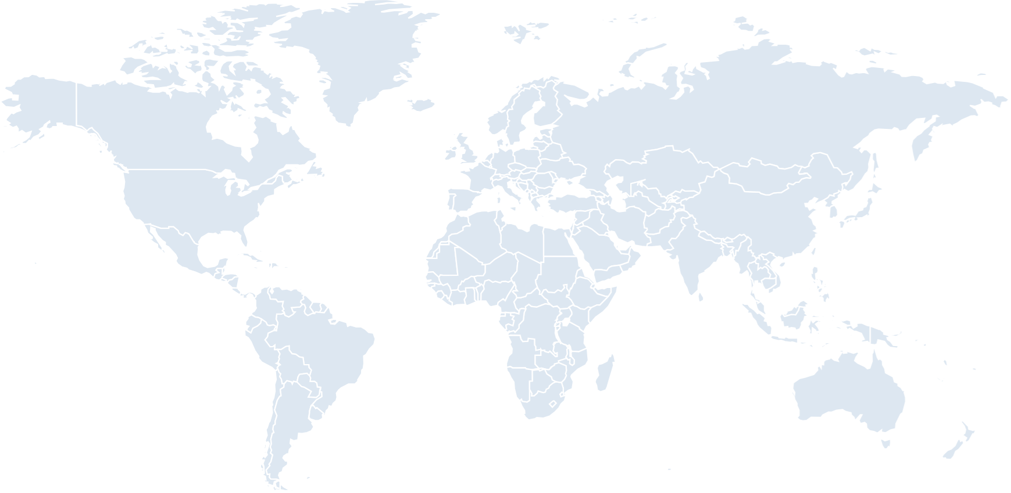
DMG’s Global Presence
In Scope for this Assessment:
Reading, Slough, Sydney
Remainder Out of Scope
Carn, Glasgow
Dublin
Leicester, Manchester
London - Reading
London - Slough
Los Angeles
New York
Sydney
Notes:
Leceister, Manchester

Slide 19
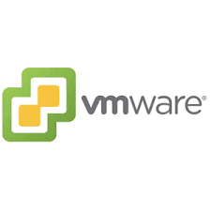
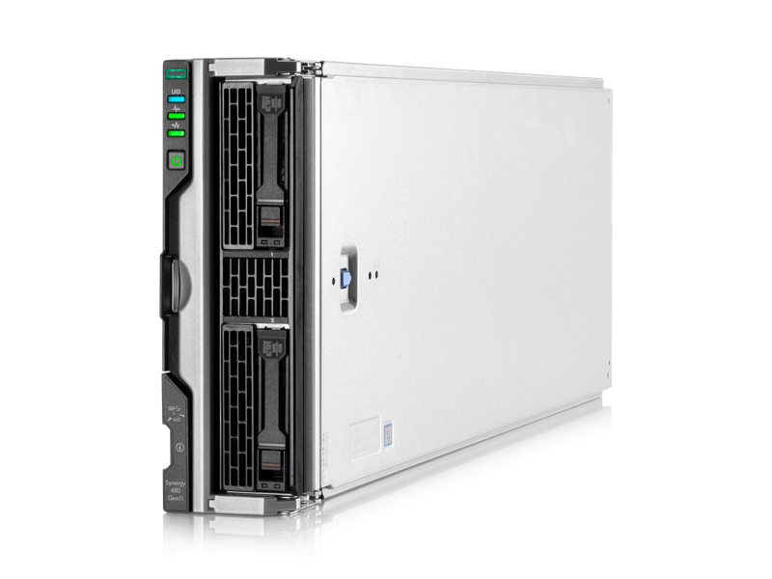
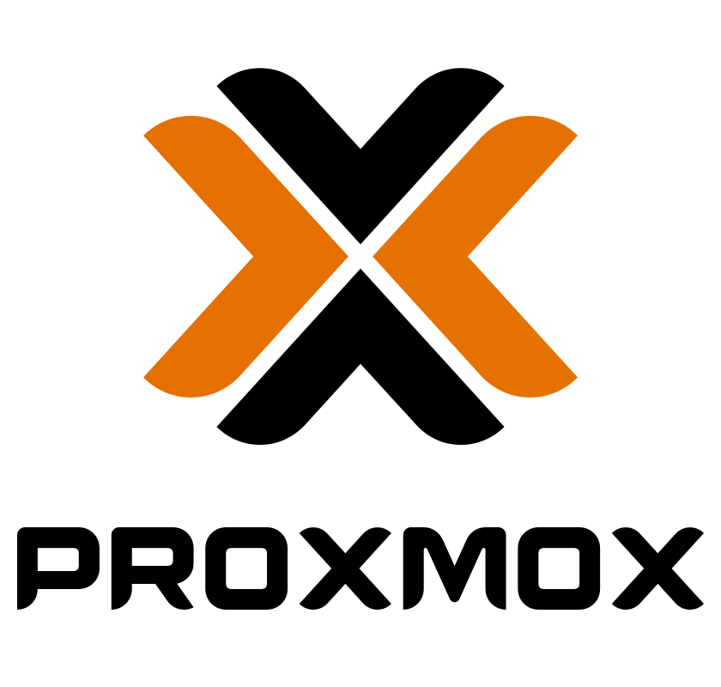
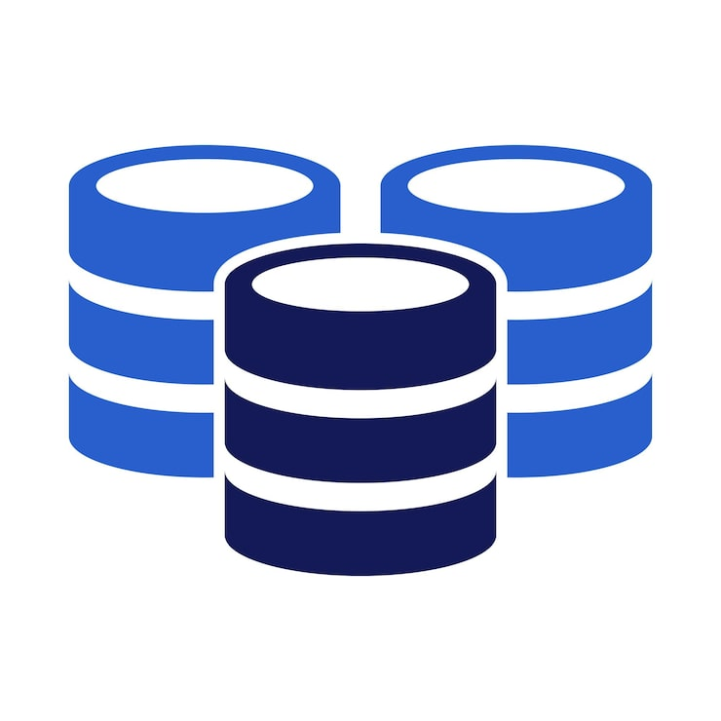
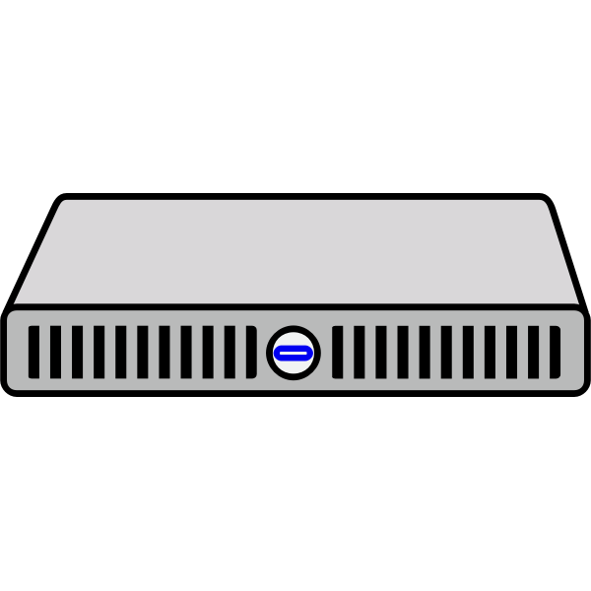

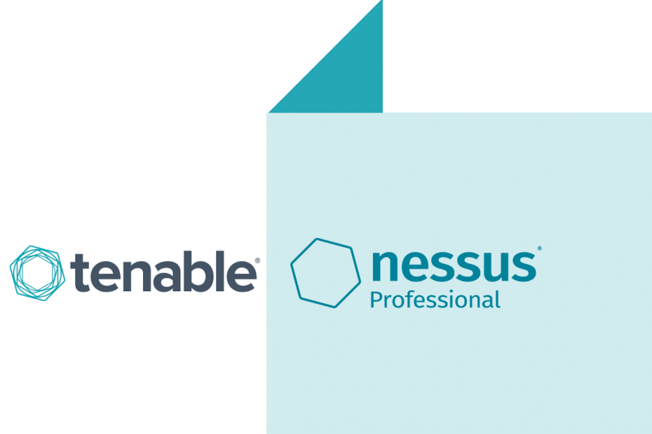
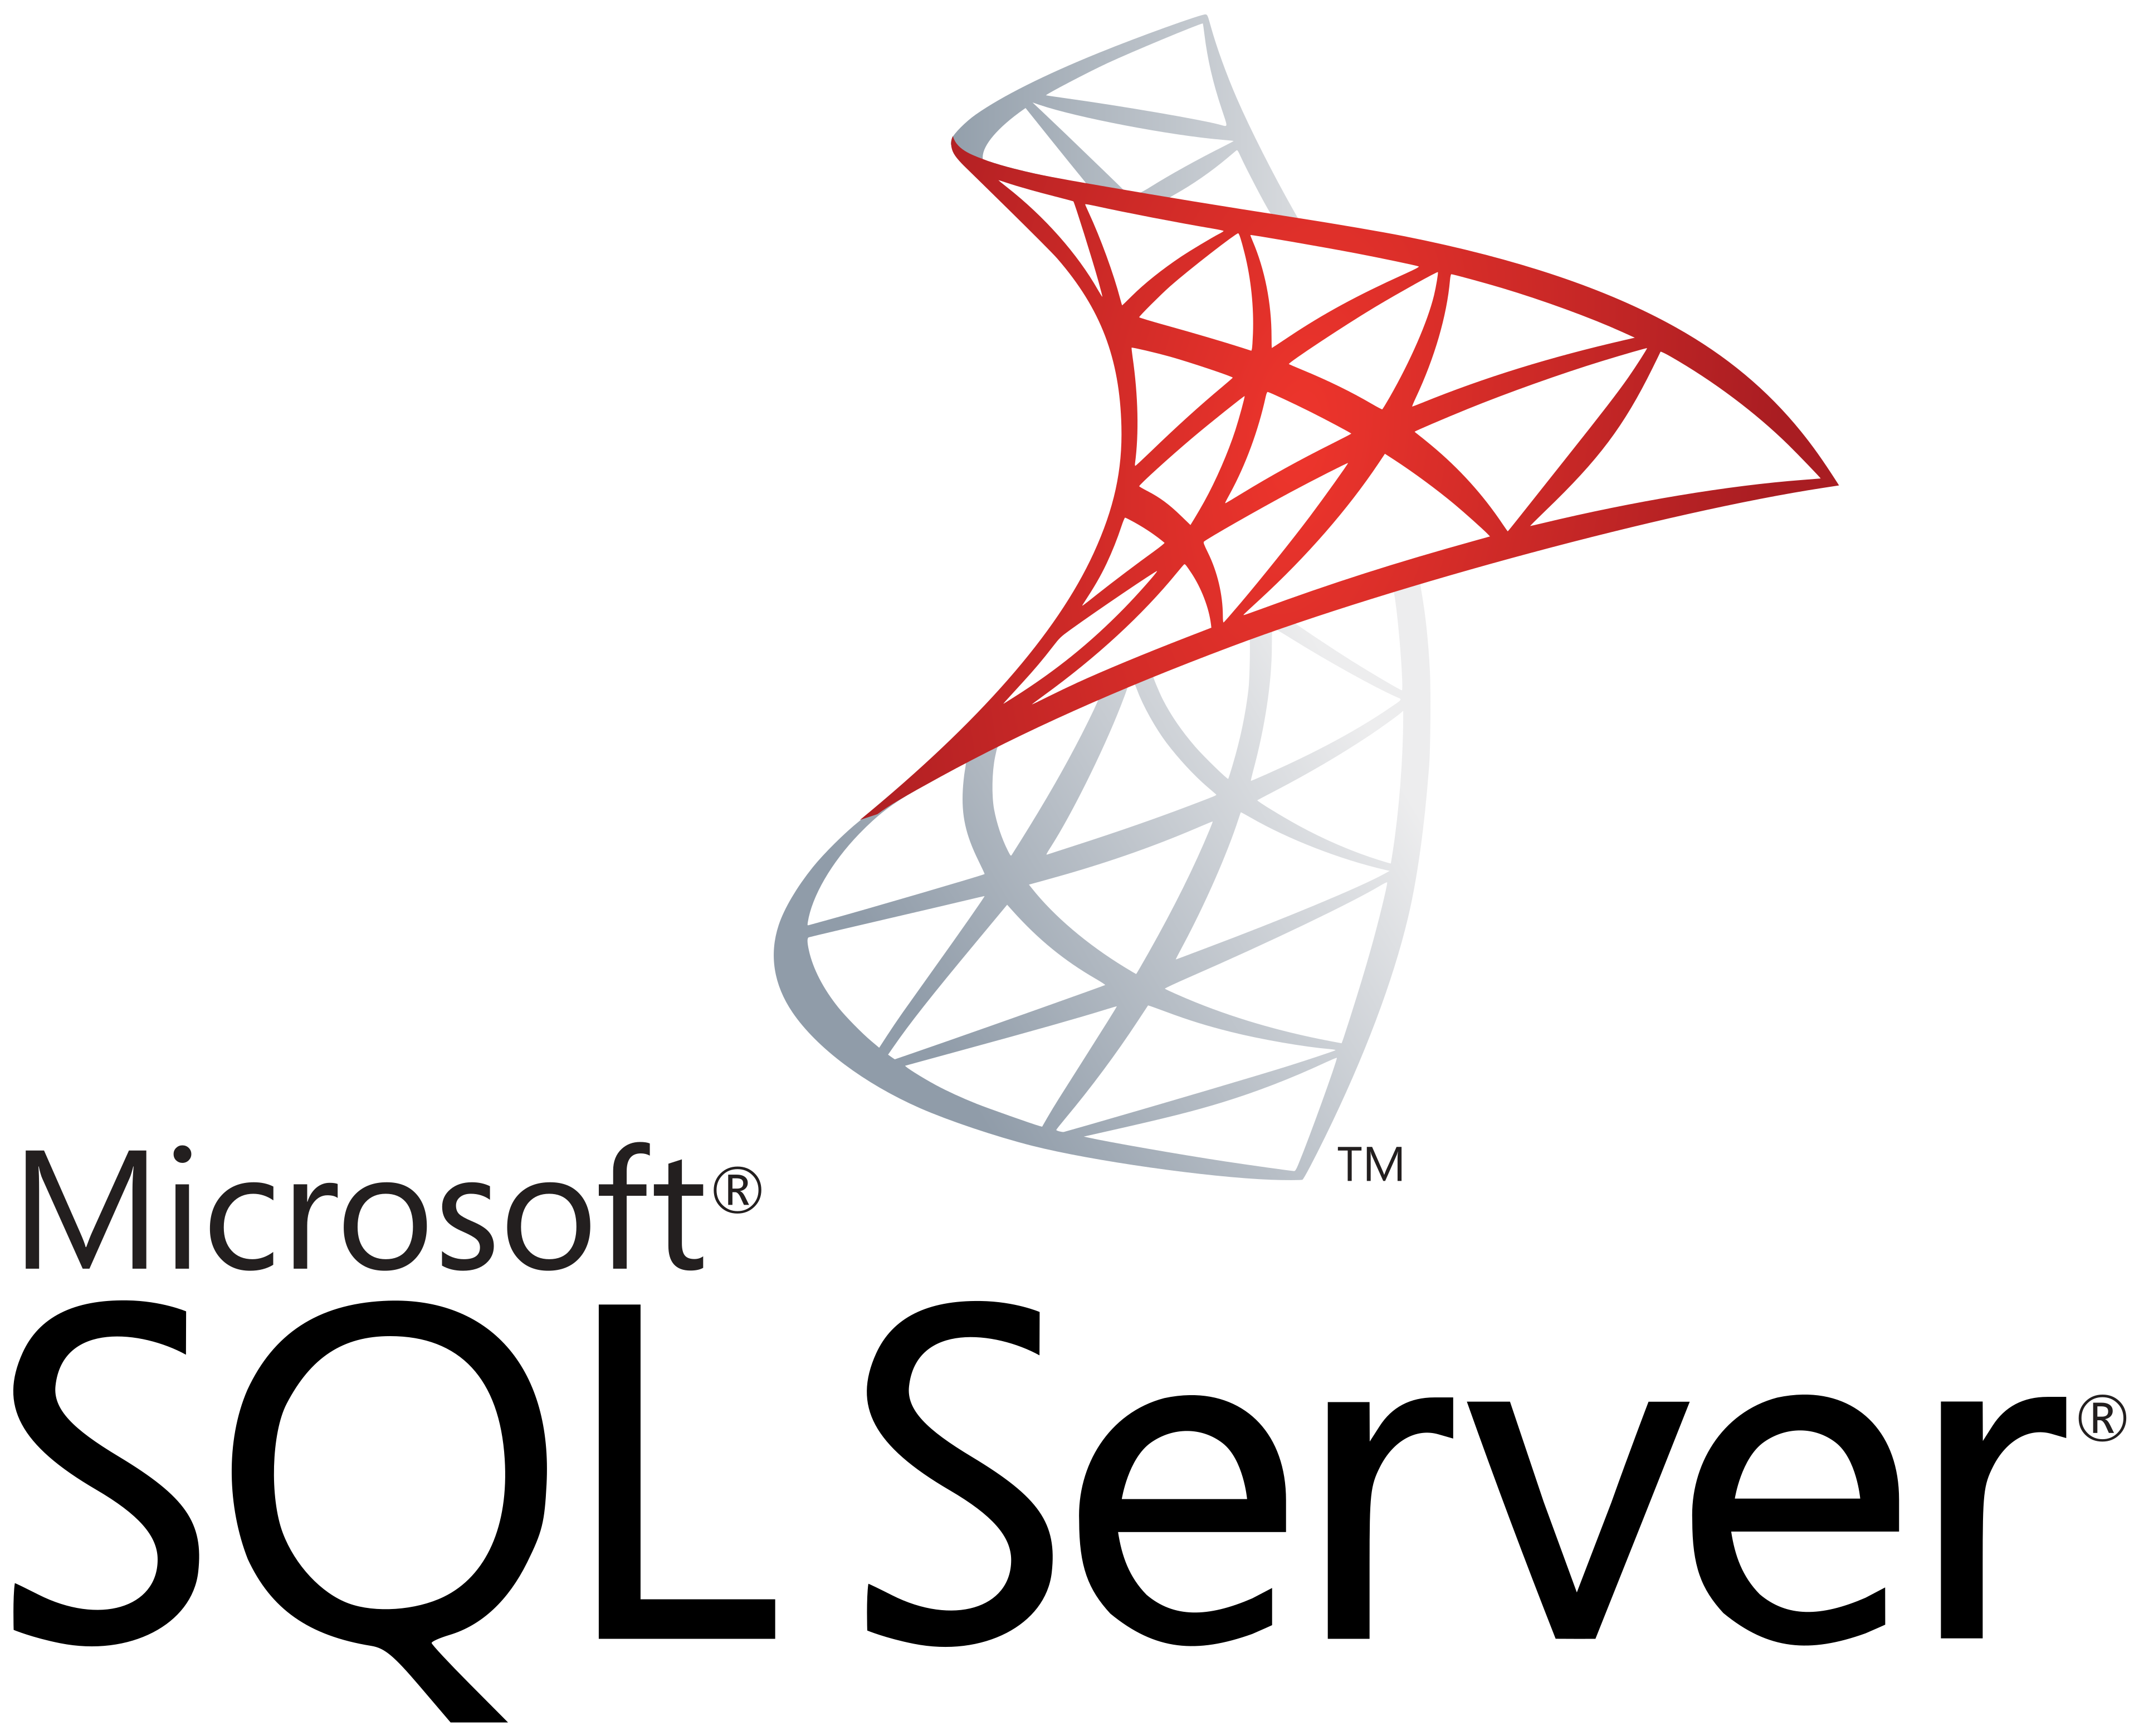
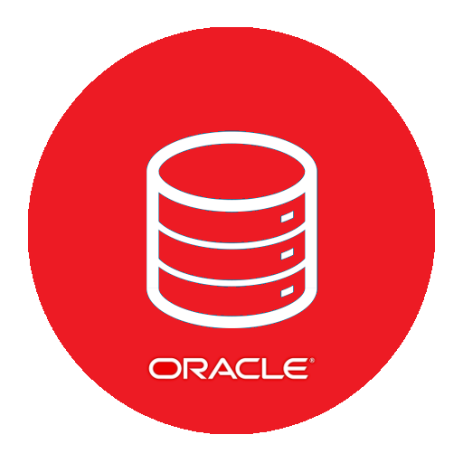

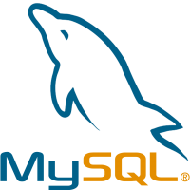

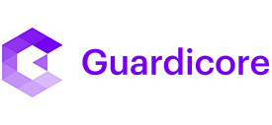




DMG Inventory Scope – At a Glance
Virtual DBServers
DBs on Physicals
2937 x
31 x
Virtual Appliances
46 x
Reading
MOL - Prod
6 x DL360
6 x 3par
6 x HPE 480 G11
1020x
No MOL proxmox
In Reading
927 x Linux
4x
3x
75 x Windows
5x
CHP – Prod
1 x DL360
1 x Primera
ANL proxmox
Reading – TEST ONLY
2x
4x
3x
12x
6 x Solaris
1x
Atex – Prod
1 x DL380
1 x Primera
Slough
41 x Proxmox
1779 x Linux
MOL - Prod + Int
8 x DL360
8 x 3par
1977x
6x
3x
MOL INT
CHP - Prod + Int
2 x DL360
2 x Primera
157 x Windows
8x
10x
6x
12x
Atex – Prod
2 x DL380
2 x Primera
6 x Solaris
1x
Sydney
29 x Linux
4x
38x
3 x Windows
2x
3038 Assets

Slide 20
Application landscape
Top 5
Mail Online: 2,206 servers (72.6%) 91 sub-components | Oracle at the centre | Dual ownership (CPO + CTO)
CHP: 146 servers (Oracle-backed, publishing operations)
WPS: 136 servers (tightly coupled to Mail Online, must co-migrate)
Atex: 109 servers (multicast constraint, business decision required)
RTA: 41 servers (significantly overprovisioned)
Remaining 29 Applications
400 servers combined (editorial tooling, shared services, retirement candidates)

Slide 21
Application Profiling Workshop findings
Mail Online is a distributed monolith Many sub-services, many dependencies, not independently releasable
Oracle is the centre of gravity MOL, Atex, CHP, Circnet all depend on Oracle. £650K/yr support.
Atex has a hard multicast constraint Cloud networks do not natively support multicast (except AWS Transit Gateway)
WPS and Mail Online must co-migrate Sustained Oracle connections to the B-cluster. Cannot be separated.
Sydney is independent 38 servers, flexible contract, natural early candidate and proof point

Slide 22
Discovery and data gaps
100% of in-scope servers discovered
97% TCO-grade data captured
9 of 9 application workshops completed
Custom automation built for 5 infrastructure types
No common credential mechanism, worked through it
MOL B-cluster: no Oracle DMA data (production primary, highest priority)
Network dependency mapping: 27.7% coverage low (guest-level collection)
Software inventory: 51.5% coverage
1,227 servers without VMware Tools (sized from provisioned spec, slightly conservative)
Legacy OS
Impact: next part planning becomes harder and requires risk based approach to planning
Mention LH column is for discovery
Mention RH column is for data gaps
Notes:
We have to ask our 5 whys. Why is network dependency mapping and software inventory so low?
Because Vmware tools was missing
Why was Vmware tools missing? Because many of these are legacy OS’es. (RHEL 6, Ubuntu 14, 16,)

Slide 23
Overall Hyperscaler Recommendation

Slide 24


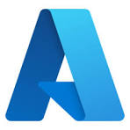
Rackspace Overall Recommendation
1st
2nd
3rd
Weighted Scoring | Close 3rd overall in weighted scoring assessment | 1st overall in weighted scoring assessment | 2nd overall in weighted scoring assessment
Cost – 3 year | Strong up-front 3 year pricing vCPU allocation - 32% of source | Competitive (< 5% difference) 3 year pricing. AWS Transform - 49% vCPU allocation. | Least attractive 3 year pricing due to limitations on tooling - 49% vCPU allocation + premium storage
Credits / Discount Programme | discounts black box through partner | industry standard best credits and discount offers | unclear position on credits/discounts
Business Fit | Strong native container solution | mixed/mostly linux workloads well suited to AWS | AHB makes a negligable difference (windows VMs = 234/3038 = 7.7%)
Internal DMG Pressure | Expected synergy with google related to Telegraph bid removed |  | Should we mention the workplace situation?
App Specific Challenges | Atex unable to run multicast without major cost + architecture refactor to unicast. | Able to run multicast natively without refactoring (Atex) | Atex unable to run multicast without major cost + architecture refactor to unicast.
App Synergy | Analytics stays on GCP | Video streaming already on AWS | need to confirm current Azure use case
Business Team Skills |  | in-house knowledge of AWS within MIMIR, Airtable, DMG iQ - Social Media & MSN Gallery Creator)
Platform Team Skills |  | Basic entry level understanding within current platform team
Readiness / Connectivity |  | on-premise connectivity (direct-connect) already configured
Partner Ecosystem |  | Largest partner ecosystem and skills market across all segments – including media
Market factors | - | - | UK South struggling for capacity
Fill all the gaps
Make AWS pop more – AWS is the only hyperscaler that can run all of your applications today.
AI use case.
Notes:
Overall Recommendations takes into account all factors
Cost – including expected credits and discounts
Weighted Scoring
Business Fit
Additional Learnings
3038 servers
14,165 vCPUs
53,758 GB Memory
1,261,841 Gb storage
Azure marked down from 2nd to 3rd due to overall quality of response and known capacity issues in UK.

Slide 25
Key Takeaways
Overall Recommendations takes into account all factors
Weighted Scoring
Business Fit
Cost - including expected credits and discounts
Additional Learnings
Cost is just one factor of many
Enabling your business to scale is critical to meet your north star targets
Update – add more weight to placing
Emphasise the positives

Slide 26
Hyperscaler
Weighted Scoring
Assessment

Slide 27
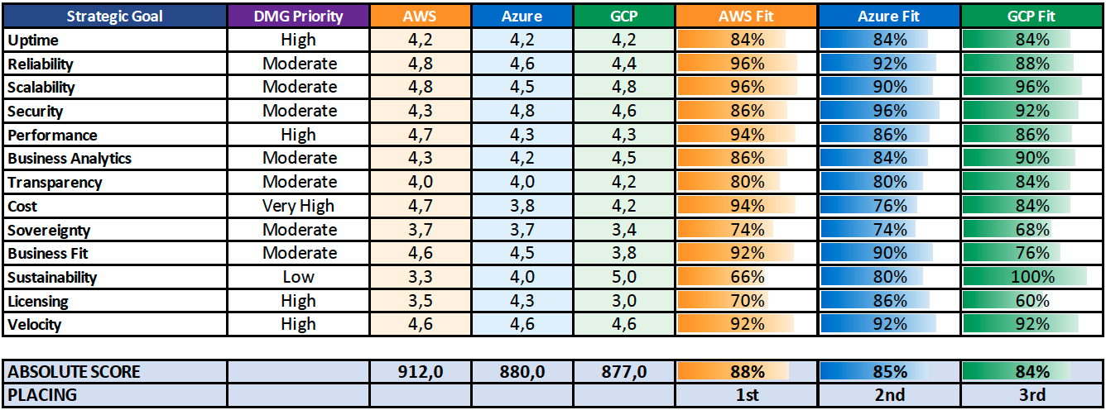

Hyperscaler Weighted Scoring
Very High
Explain these gaps
Notes:
Note how close the overall scores for 2nd and 3rd place are…. It’s very tight.
We answered the questions honestly amongst the 3 dedicated architects and didn’t look at the scores.

Slide 28
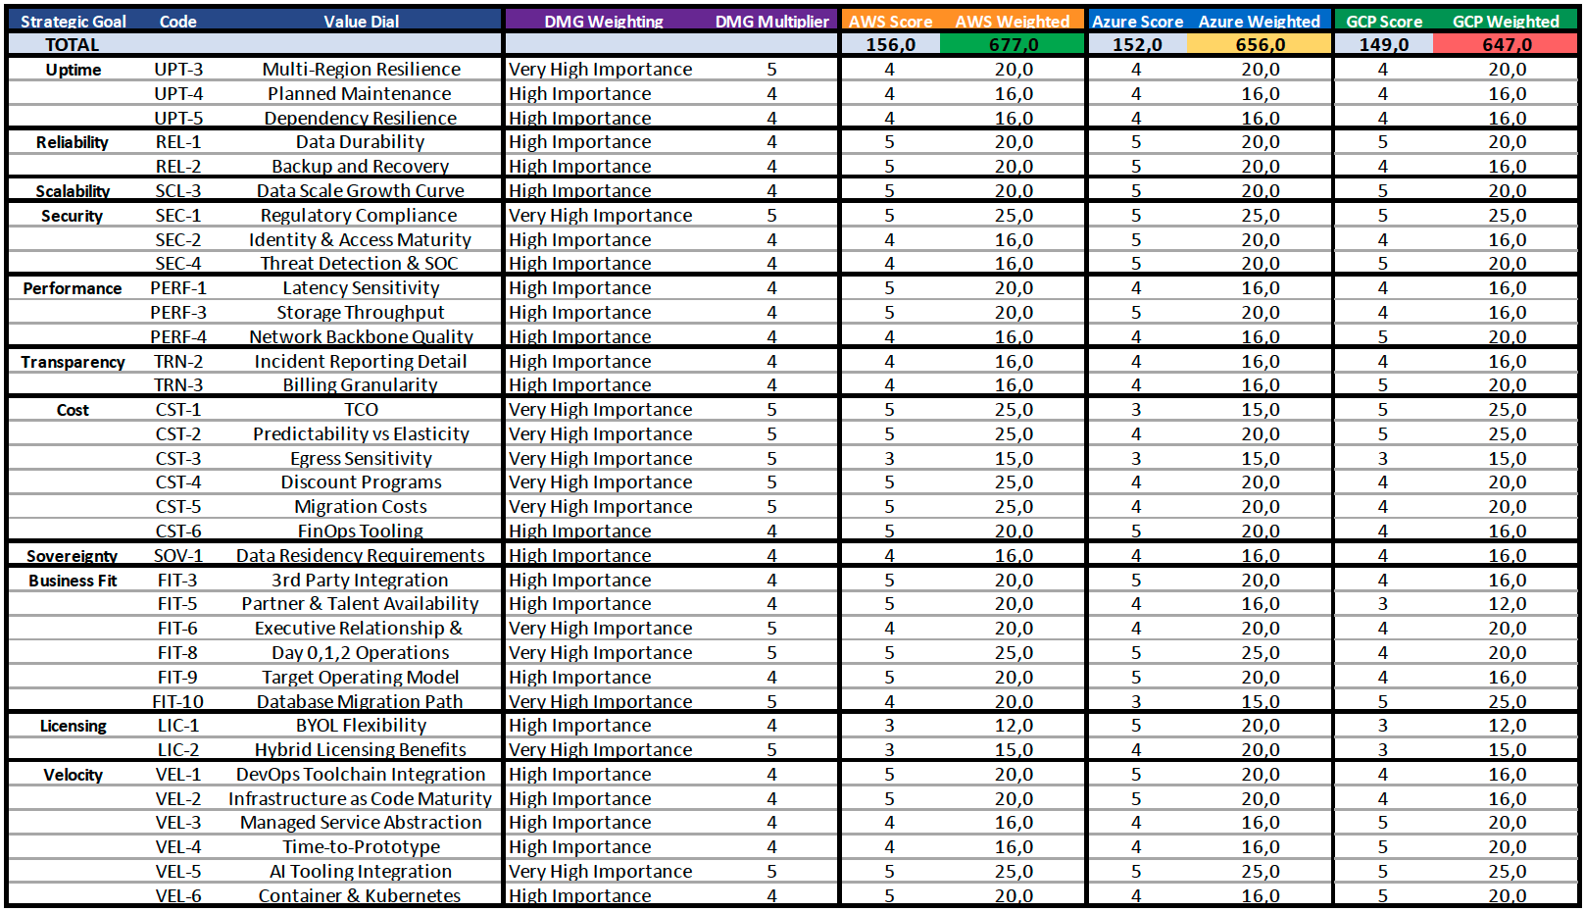
Weighted Scoring – DMG Key Value Dials
Notes:
A drilldown specifically highlighting the Value Dials that you rated as either High or Very High Importance to your business.

Slide 29
Business and Application Fit

Slide 30
Technical constraints
Atex multicast Prestige clustering requires multicast for node discovery. AWS supports natively via Transit Gateway. GCP and Azure do not. Vendor engagement on unicast is a Part 2 action.
Oracle RAC Shared storage, cluster interconnect. Exadata@Cloud available on all three platforms in London. Same OCI pricing. This is not a differentiator between clouds.
SQL Server Datacenter BYOL with Software Assurance. Azure AHB is simplest. AWS and GCP require Dedicated Hosts or Sole Tenant. Windows Server 2022 BYOL blocked on AWS and GCP (Listed Provider rules).
Three constraints that shape the approach

Slide 31
AWS Business Fit
Why does AWS fit better than the others
Update – add more weight to placing
Emphasise the positives

Slide 32
Cost Comparison

Slide 33
How we built the numbers
Same source data fed to all three clouds. No cloud got a different version of the estate.
Each cloud's own tool sized the workloads (Migration Center, Transform, Azure Migrate)
SKU audit of what each tool recommended and why
Re-priced against live APIs to neutralise tool-specific bias
Two pricing pillars: on-demand baseline and 3-year committed
Oracle modelled separately (three distinct paths, different mechanics per cloud)
Commercial layer separate (partner discounts and credits, not mixed into the baseline)
Methodology / Assumptions
Notes:
Key Emphasis is on the same dataset being used for everyone

Slide 34
DMG – On-Premise Costs
Category | Subcategory | Cost Item | Description / Scope | Vendor | Portability / Entitlements | Cost Type | Input Basis | Input Amount (GBP) | Dep. (yrs) | Annualized Cost (GBP)
Compute & Storage | Server Hardware | Server hardware costs (purchase/lease) | Purchase/lease costs; include depreciation schedule and refresh cycle | TBD | TBD | Capex | Capex | £1,262,234 | 5 | £252,447
Compute & Storage | Hardware Maintenance | Hardware maintenance | Annual maintenance/support for server hardware | TBD | N/A | Opex | Annual | £5,000 |  | £5,000
Compute & Storage | Storage | Storage (SAN/NAS + backup) | SAN/NAS + backup infrastructure (capex + support) | TBD | TBD | Capex | Capex | £1,451,571 | 5 | £290,314
Compute & Storage | Virtualization | VMware licensing (vSphere/vCenter/vSAN) | Include vSphere, vCenter, vSAN (if applicable) | VMware | TBD | Opex | Annual | £0 |  | £0
Software Licensing | Operating System | Windows Server licenses | Windows Server licensing for on-prem infrastructure | Microsoft | Software Assurance / BYOL TBD | Opex | Annual | £136,825 |  | £136,825
Software Licensing | Operating System | Linux (RHEL/SUSE) licenses | If applicable: RHEL/SUSE subscriptions | Red Hat/SUSE | BYOL not typical | Opex | Annual | £71,000 |  | £71,000
Software Licensing | Operating System | Ubuntu patching / support | Landscape/Ubuntu support and patching tools | Canonical/TBD | TBD | Opex | Annual | £20,000 |  | £20,000
Software Licensing | Database | SQL Server licenses | SQL Server licensing (core/CAL as applicable) | Microsoft | SA / BYOL TBD | Opex | Annual | £118,968 |  | £118,968
Software Licensing | Database | Oracle Support/Maintenance | Per-core/per-socket details help | Oracle | BYOL terms TBD | Opex | Annual | £650,000 |  | £650,000
Operations | Database | Database Support | NCS SUPPORT | NCS | N/A | Opex | Annual | £568,000 |  | £568,000
Software Licensing | Database | MySQL Enterprise / support | MySQL enterprise subscription/support if used | MySQL | BYOL TBD | Opex | Annual | £0 |  | £0
Software Licensing | Security / Other | Tenable / Guardicore (if applicable) | Any other commercial software tied to infrastructure - Per Server! | Tenable/Guardicore | Portability TBD | Opex | Annual | £443,888 |  | £443,888
Software Licensing | Other | Other commercial infra software (none yet) | Placeholder for any additional commercial infra software | N/A | N/A | Opex | Annual |  |  | £0
Facilities & Network | Colocation / Facility | Colocation / facility costs - Reading | Power, cooling, rack space; per site if different (MOL vs ANL) | Centre Square | N/A | Opex | Annual | £386,400 |  | £386,400
Facilities & Network | Colocation / Facility | Colocation / facility costs - Slough | Power, cooling, rack space; per site if different (MOL vs ANL) | Digital Realty | N/A | Opex | Annual | £338,300 |  | £338,300
Facilities & Network | Colocation / Facility | Colocation / facility costs - Sydney | Power, cooling, rack space; per site if different (MOL vs ANL) | Equinix | N/A | Opex | Annual | £40,000 |  | £40,000
Facilities & Network | Network | Interconnect between sites | Bandwidth / interconnect costs between sites | TBD | N/A | Opex | Monthly | £1,600 |  | £19,200
Facilities & Network | Internet | WAN/Internet egress costs | Internet connectivity (egress) costs | ISP/TBD | N/A | Opex | Monthly | £8,000 |  | £96,000
Operations | Vendor Support | Vendor support contracts | All vendor support contracts for infra | TBD | N/A | Opex | Annual | £20,000 |  | £20,000
Operations | People | Infra management FTE | IT staff dedicated to physical infra management (approx FTE) | Internal | N/A | Opex | Annual | £100,000 |  | £100,000
Contracts & Commitments | Lock-ins | Existing contract lock-ins | VMware EA, hardware leases, colo agreements and end dates | TBD | N/A | Opex | Annual | £0 |  | £0
Contracts & Commitments | Refresh | Planned hardware refreshes (next 12-24 months) | Planned capex refreshes in next 12-24 months | TBD | N/A | Capex | Capex | £200,000
Contracts & Commitments | Support | Microsoft Support (MS Family) | Support that may need replacing if moving from MS EA | Bluesource (Accredited Partner) | TBD | Opex | Annual | £80,000 |  | £80,000
Total |  |  |  |  |  |  |  | £ 5,901,786 |  | £ 3,636,342

Slide 35
DMG – On-Premise Costs Discussion
Key Points:
On Premise Costs as you shared with us
We didn’t share this with the hyperscalers
There are still some TBD’s in the list
Missing is some hardware costs that you couldn’t find invoices for
Vmware support costs are shown as 0
DMG bought perpetual licenses, but this doesn’t give you support.
Expiring Support and Subscription (SnS). Without active SnS, there is no access to patches, security updates, or support, and no ability to add new ESXi hosts.
Proxmox partially addresses the expansion challenge, but still has no support
Security risk – Mithral (Anthropic) will find these vulnerabilities
VEEAM costs + network switch costs net to zero .. You will pay these both in cloud and on premise.
Outcome:
This is a best case number, reality is that on-prem costs more than this
Notes:
Broadcom has ended perpetual licensing for new purchases. The only path to continued support is a VCF subscription. (Source: Broadcom KB Article 429208, referenced in the CRA report prompt.)
https://knowledge.broadcom.com/external/article/429208/perpetual-license-functionality-after-su.html

Slide 36
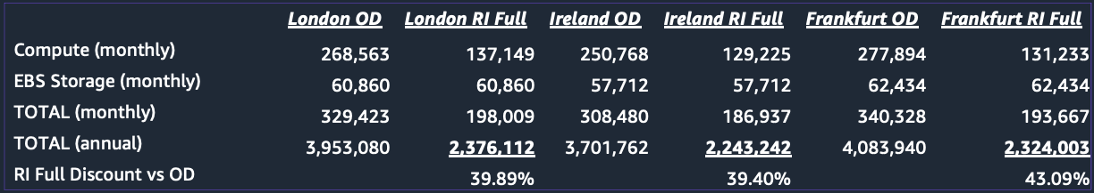
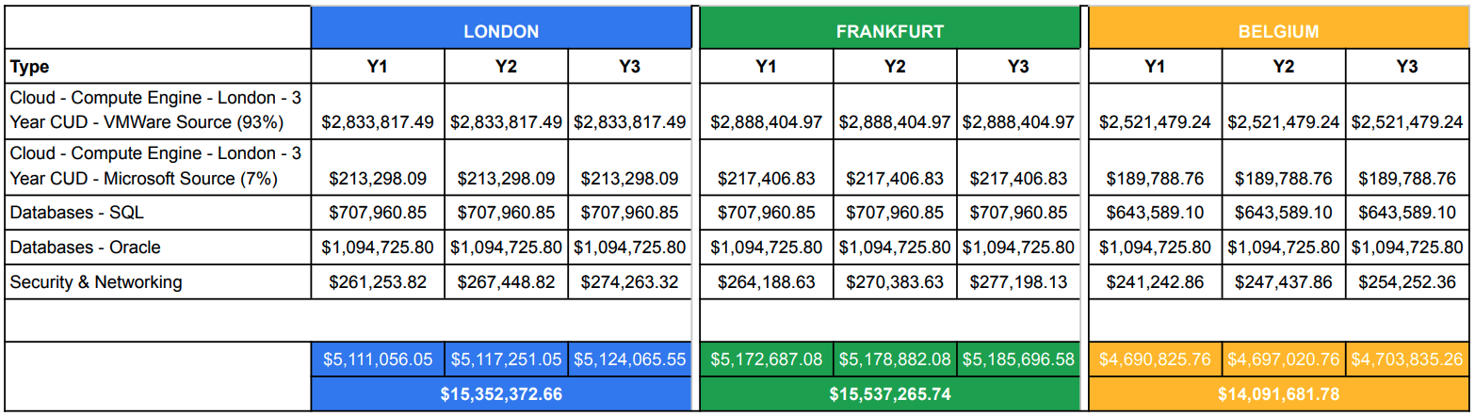
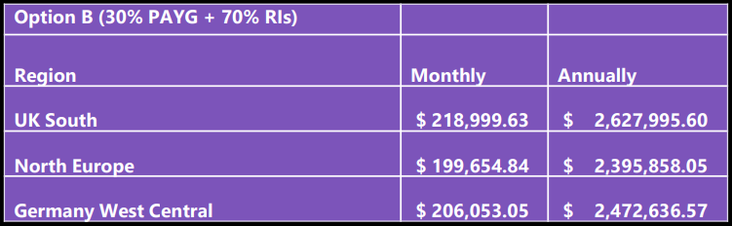
Hyperscaler Offerings
Scott working on this now
3 year reserved pricing – no discounts applied
Create a matrix showing all 3.
Keep currencies in GBP .
Highlight the differences.
Notes:
Avoid focusing on the numbers themselves.
There will be differences.

Slide 37
Hyperscaler Offerings
3 year reserved pricing – no discounts applied
USD <> GBP conversion | 0,755
AWS
Region | London OD | London RI Full | Ireland OD | Ireland RI Full | Frankfurt OD | Frankfurt RI Full
Compute (monthly) | $268.563 | $137.149 | $250.768 | $129.225 | $277.894 | $131.233
EBS Storage (monthly) | $6.086 | $6.086 | $57.712 | $57.712 | $62.434 | $62.434
TOTAL (monthly) | $329.423 | $198.009 | $30.848 | $186.937 | $340.328 | $193.667
TOTAL (annual) - USD | $3.953.080 | $2.376.112 | $3.701.762 | $2.243.242 | $4.083.940 | $2.324.003
TOTAL (annual) - GBP | £2.984.575 | £1.793.965 | £2.794.830 | £1.693.648 | £3.083.375 | £1.754.622
RI Full Discount vs OD |  | 39.89% |  | 39.40% |  | 43.09%
Azure - Option B (30% PAYG + 70% RIs)
Region | UK South - OD | UK South - RI | North Europe OD | North Europe RI | GWC - OD | Germany West Central - RI
TOTAL (monthly) |  | $219.000 |  | $199.655 |  | $206.053
TOTAL (annual) - USD |  | $2.627.996 |  | $2.395.858 |  | $2.472.637
TOTAL (annual) - GBP |  | £1.984.137 |  | £1.808.873 |  | £1.866.841
GCP
Indicative Pricing - GCE CUDS Applied
 | LONDON | LONDON | FRANKFURT | FRANKFURT | BELGIUM | BELGIUM
Cloud - Compute Engine - London - 3 Year CUD - VMWare Source (93%) |  | $2.833.817 |  | $2.888.405 |  | $2.521.479
Cloud - Compute Engine - London - 3 Year CUD - Microsoft Source (7%) |  | $213.298 |  | $217.407 |  | $189.789
Databases - SQL |  | $707.961 |  | $707.961 |  | $643.589
Databases - Oracle |  | $1.094.726 |  | $1.094.726 |  | $1.094.726
Security & Networking |  | $267.655 |  | $270.590 |  | $247.644
TOTAL (annual) - USD |  | $5.117.458 |  | $5.179.089 |  | $4.697.227
TOTAL (annual) - GBP |  | £3.863.680 |  | £3.910.212 |  | £3.546.407

Slide 38
Cloud Infra Cost Comparison – PAYG vs. 3 Year Commitment
Key Points:
AWS + GCP pricing are very closely matched (2%)
We priced independent of the Hyperscaler offerings
Same source data was fed to all three hyperscaler tools
3038 servers
14,165 vCPUs
53,758 GB Memory
1,261,841 Gb storage
We focused on agnostic comparison using the source data
GCP tooling can create custom sizing (mem)
Our numbers provide a strong baseline for a Part 1 independent comparison
Generated: 15 April 2026 19:51
Servers in scope: 3,038 | Currency: GBP | FX Rate: 1 USD = 0.755 GBP
All pricing API-verified: AWS Price List API | GCP Billing Catalog API | Azure Retail Prices API
PAYG Component Breakdown (Monthly)
 |  | London
 | AWS | GCP | Azure
Compute | £228,907 | £196,025 | £228,410
Storage | £63,587 | £91,005 | £159,446
OS License | £21,105 | £9,883 | £17,582
Network (5%) | £14,625 | £14,351 | £19,393
Total - Monthly | £328,223 | £311,264 | £424,831
Annual (GBP) | £3,938,677 | £3,735,172 | £5,097,970
3yr Commitment Pricing Breakdown (GBP)
 |  | London
 | AWS | GCP | Azure
Total - Monthly | £190,285 | £186,974 | £274,881
Annual | £2,283,419 | £2,243,685 | £3,298,566
Savings % | 42.0% | 39.9% | 35.3%
Assumptions:
All pricing verified via official cloud APIs (GCP Billing Catalog, AWS Price List, Azure Retail Prices)
GCP and Azure rates in native GBP from API. AWS rates in USD, converted at corporate FX rate above.
PAYG = on-demand. 3yr = GCP CUD / AWS 3yr Standard NURI (per-instance from API) / Azure 3yr RI
Storage: GCP Balanced PD/Hyperdisk (SSD), AWS gp3 (per-region from API), Azure Premium SSD
Network: 5% of (compute + storage) - standard cloud estimate estimate
OS licensing: Windows/RHEL at PAYG surcharge rates. SQL Server and Oracle licensing in separate workbook.
Instance mapping: GCP Migration Center, AWS Transform, Azure Migrate - all architect-assigned
All 3 clouds sized from the same source dataset (GCP Migration Center export, 3,038 servers in scope)
Not included: backup/DR, management tooling, migration execution, double-run overlap, egress, headcount, VMware savings
Notes:
On a 3-year committed basis in London, GCP is the cheapest by approximately 2% over AWS.
What does “apples-to-apples” mean?
The same source data (server specifications, memory, storage, operating system) was fed to all three hyperscalers .
Block storage (SSD class, IOPS-matched across clouds at 80,000 IOPS per disk where needed) – Explaining Large Azure Storage Variance
Ensured that burstable VM families were excluded across all three clouds by team agreement as not suitable for production workloads.
Consistent “Comfort factor” and “Utilisation percentile” applied
Even then, the tooling has differences. The cost spread reflects how each cloud's own assessment tool sized the same source workload.
GCP Migration Center produced the smallest vCPU allocation at 32% of source, using custom instance shapes down to 1 vCPU. This drives their licensing costs down as cores are licensed.
AWS Transform sat at 49% vCPU allocation.
Azure Migrate sat at 53%, typically assigning F2s_v2 (2 vCPU minimum) across most of the estate because its sizing algorithm did not generate 1-vCPU SKUs for production workloads and F-series SKU availability with 3-year Reserved Instance coverage in London shapes the options available.
Methodology
Data normalisation. The same source data (server specifications, memory, storage, operating system) was fed to all three hyperscalers .
Architectural benchmarking. Each cloud's own sizing tool (GCP Migration Center, AWS Transform, Azure Migrate) produced right-sized target configurations. The native tools did the sizing. Their outputs are the starting point, not the final answer.
AI logic audit. We audited the SKU mappings each tool produced. Different tools use different optimisation logic. We checked what each tool assumed and why.
Bias mitigation. To remove tool-specific bias, we re-priced every recommended SKU against the official cloud pricing APIs (AWS Price List API, Azure Retail Prices API, GCP Billing Catalog API). This produced a validated, normalised view. The provider-native outputs are kept for internal validation only.
Two pricing pillars. We report on-demand (the clean baseline) and 3-year committed (the realistic commitment for an organization of your scale). One-year commitments are deprioritised as a less attractive option.
Partner and commercial pricing is a separate layer. This sits on top of the normalised baseline. Where commercial offers are not yet received, the layer is flagged [PENDING ] rather than inferred.
Oracle scenarios are modelled separately. Oracle has three fundamentally different migration paths, each with different pricing mechanics. These are separated rather than averaged into compute cost.
This methodology is what gives the figures credibility when each cloud provider presents their own view directly. Your technical panel can verify any number against a specific API response and data normalisation step.

Slide 39
Cost Comparison - TCO
COMPLETE VIEW (Baseline + Oracle Exadata + Savings)
Cost | GCP (per month) | AWS (per month) | Azure (per month)
+ Baseline 3yr | £186,974 | £190,285 | £274,881
- Windows BYOL (SA assumed) | -£7,220 | -£8,605 | -£17,529
-SQL SERVER (33 instances, 132 cores) | TBC | TBC | TBC
- Storage tiering (non-prod to HDD) | -£18,603 | -£10,261 | -£9,964
+ Option A: Oracle Exadata@Cloud (keep RAC, keep Oracle) | £42,909 | £42,909 | £42,909
+ Oracle support (GBP 650K/yr, retained under BYOL) | £54,167 | £54,167 | £54,167
Ubuntu patching / support | £1,667 | £1,667 | £1,667
+Database Support (NCS) | £47,333 | £47,333 | £47,333
+ Tenable / Guardicore (if applicable) | £36,991 | £36,991 | £36,991
+ Microsoft Support (MS Family) | £6,667 | £6,667 | £6,667
+ Hyperscaler Support (Enterprise) | £18,697 | £16,688 | £24,107
+ Internet egress at 100TB per month - illustrative, Part 2 to quantify actual volume | £6,274 | £5,889 | £4,832
COMPLETE VIEW (Monthly) | £375,856 | £383,729 | £466,060
COMPLETE VIEW (Annual) | £4,510,268 | £4,604,751 | £5,592,724
On Prem Comparison | £3,636,342 | £3,636,342 | £3,636,342
Differential | £873,927 | £968,410 | £1,956,383
BASELINE (3yr Committed, London, Monthly) Includes: compute, storage, OS, 5% network placeholder (inter-zone/region), Oracle (Option A Exadata@Cloud), Oracle support retained under BYOL, Windows + SQL Server BYOL (SA assumed) SQL surcharge is not added because SA is assumed in place
Key Points:
Windows BYOL – 2019 Only vs AHB
SQL ??? How exactly does it net to 0?
Oracle Exadata@Cloud presents a good opportunity
DevTest doesn’t need premium spec SSDs
vs. £3,636,242 On-Premise Cost
Credits and Discounts not included
Notes:
Egress - API-verified rates: AWS 0-10/10-50/50-150TB = $0.09/$0.085/$0.07 per GB | Azure (Internet) = $0.08/$0.065/$0.06 per GB | GCP Premium = $0.12 first 1TB, $0.11 to 10TB, $0.08 above

Slide 40
Hyperscaler Funding Summary
Total cloud spend (3-yrs committed annual) | $ 3,024,396 | $ 4,368,962 | $ 2,243,685
Total Partner Payment (A) (to discount migration cost) | $ 1,757,600 |  | $ 1,080,498
Total Hyperscaler Credits (B) (to offset Cloud consumption) | $ 756,099 | - | $ 745,192
Total funding in USD (A+B) | $ 2,513,699 | - | $ 1,825,690
Total funding in GBP* | £ 1,897,842 |  | £ 1,378,396
AZURE NUMBERS TBD
Note the hyperscaler funding figures are indicative only based on established funding programs – subject to approval.
*FX Rate 1 USD = 0.755 GBP

Slide 41
DMG Readiness

Slide 42
Readiness today
Your team has deep expertise in VMware, Oracle, and networking. This score measures cloud readiness only.
Business: 2.5
Objectives clear. Operating model definition is the gap.
Governance: 3.0
Strongest area. CMDB maintained, supplier management mature.
Operations: 1.8
DR planning and cross-brand monitoring consistency are the gaps.
People: 1.2
Cloud-specific skills at earliest stage. No formal training plan yet.
Security: 2.0
CISO engaged. Shared responsibility model and cloud-native GRC early-stage.
Bottom line: Overall: 2.1 of 5. Consistent with an organisation at the start of its cloud journey.
Cloud-specific, not overall capability
Needs Chart and articulation of the scale ie 5 is good or 1 is good

Slide 43
Closing the gap
Current
Business: 2.5
Governance: 3.0
Operations: 1.8
People: 1.2
Security: 2.0
Overall: 2.1
12 Month target
Business: 4.0
Governance: 4.0
Operations: 3.0
People: 3.0
Security: 4.0
Overall: 3.6
Current state to 12-month target
How it closes:
Landing zone build establishes governance, security baselines, and IaC from day one
Partner-assisted delivery carries the specialist load during transition
Your team works alongside, absorbing capability cohort by cohort
End state: Customer-led cloud operation with internal capability built in-flight

Slide 44
Challenges

Slide 45
Challenges Observed
Why will this be complex to migration
Skills Gap
Vmware Tools
Appliances
Cloud Skills required
Suggest partner to aid during transition phase
Build fully featured LZ
Assist with migrations
Develop core security practices
Build foundational FinOps concept
Develop DevOps automation processes
Upskill in-house team
Where possible having vmware tools enabled gives a better perspective of performance inside the VM
Update where possible
challenge
response
Standardised Access
Legacy OS
Naming Conventions
Consistent logins required for administrator access
Old unsupported OS types will take longer to move to Cloud
Risk of duplication or accidentally leaving out of migration
Standardised login methods for Linux/Windows
Standardised accounts across MOL/ANL
Ability to make changes
Some customers prefer to use a tool to manage PAM. (eg: Cyberark)
Replatforming is possible but must be factored into timeline.
Same hostnames with .int and .hsk

Slide 46
Opportunities

Slide 47
Quantified opportunities
Oracle modernisation to PostgreSQL | £45-65K/mo saving (£540-780K/yr) Eliminates £650K/yr support contract. Requires Part 2 assessment. Conversion cost not yet estimated.
Windows BYOL | £7-18K/mo saving depending on cloud Requires active SA. Cost-effective on Azure (AHB). On AWS/GCP only while EA is active (expires May 2027).
SQL Server BYOL | £14-15K/mo saving across all clouds Requires SA confirmation from Bluesource. Cost-effective on all three platforms.
Storage tiering | £10-19K/mo saving depending on cloud 336 TiB non-production moved from SSD to HDD class. No application impact.
RTA rightsizing | Saving TBD (Part 2 to quantify) Many instances significantly overprovisioned. Right-size during migration for immediate saving.
Modelled in Part 1
Have these savings been factored into the TCO comparison

Slide 48
Strategic opportunities
Sydney datacentre exit 4 servers, flexible contract, £40K/yr cost offset. Low-risk proof point. Migrate early.
Application rationalisation Lotus Notes (SaaS replacement), Atex 5.5 (32-bit, retire when Atex 6 complete), SolarWinds and Zabbix (replace with cloud-native monitoring). Every app retired is servers removed from migration scope.
Load balancer modernisation F5 (corporate) and Zeus/Ivanti vTM (Mail Online) replaced by cloud-native. No hardware lifecycle, auto-scaling, native integration.
Observability consolidation Replace SolarWinds and Zabbix with a single cloud-native or cloud-agnostic monitoring platform. Consistent across brands.
Infrastructure as Code from day one All cloud provisioning via Terraform or cloud-native equivalent. Reproducible, auditable, eliminates manual configuration errors.
Part 2 to validate

Slide 49
Moving Forward and Part 2

Slide 50
Plan – Cloud Readiness Assessment
Part 1 (Orange) & Part 2 (Red)
Part 3
Migration / Modernisation Design & Execution
Part 4
Post-Migration
Governance
Governance
TCO Analysis
Tooling & Discovery
Migration Runbooks
Data Strategy
Server/App Profiling
Modernisation Runbooks
Business Strategy
Dependency Mapping
PoC Candidates
Migration Execution
Transition to
Managed Service
Infra & Security Assessment
High-Level
Release Plan
Landing Zone Design
Testing & Remediation
Public Cloud Recommendation
Indicative Modernisation Path
Landing Zone Build
Integration in Target
Landing Zone Test
Notes:
Reminder of

Slide 51
Migration cohorts
Cohort 0: Foundation | 5 apps, 95 servers AD, monitoring, security, config management. Must exist before anything migrates.
Cohort 1: Quick wins | 13 apps, 63 servers Independent, well-discovered, clear cloud fit. Early value and operational experience.
Cohort 2: Planned | 17 apps, 425 servers Some database dependencies, mixed infrastructure. Manageable complexity.
Cohort 3: Complex | 2 apps, 2,342 servers (77%) Mail Online + WPS. Oracle dependency. 91 sub-components. This is the programme.
Cohort 4: Decision required | 2 apps, 113 servers Atex + InstantPress. Multicast constraint. Cannot progress until unicast decision is made.
Five cohorts, one critical path

Slide 52
Co-migration groups
Mail Online + WPS: WPS maintains sustained Oracle connections to the B-cluster. Splitting them breaks the publishing pipeline.
ECO3 + OneVision: OneVision reads from ECO3's courier database via SMB (port 445, network-confirmed).
Atex + InstantPress: InstantPress produces PDF output from Atex content. Coupled by data flow.
What this means These groups are scheduling constraints. Part 2 builds the release plan around them. You cannot pick applications for convenience. You pick them by coupling.
Applications that must move together

Slide 53
What you need to do now
Data to provide
SA confirmation from Bluesource (unblocks BYOL modelling)
Broadcom VCF subscription quote (completes cost of doing nothing)
MOL B-cluster DMA access (largest database, currently sized from hardware spec only)
Decisions to make
Primary platform (this assessment recommends AWS)
Atex vendor engagement on unicast support
Oracle path: Exadata@Cloud now, PostgreSQL timing for Part 2
Day 2 operating model (partner-assisted with upskilling)
CPO and CTO joint sponsorship for Mail Online
Data and decisions

Slide 54
Part 2 entry point
Discovery and profiling Extend to full 4,500+ estate. MOL B-cluster DMA. Deep performance profiling. Per-application 7R classification.
Architecture and design Landing zone design. Security posture assessment. Network and load balancer modernisation. Guardicore policy migration.
Data and modernisation Oracle modernisation assessment (highest-value workstream). SQL Server per-instance assessment. PostgreSQL feasibility.
Planning and governance Cohort sequencing with timeline. Co-migration group scheduling. Dual-run cost modelling. Cloud Platform Team formation. Staff training roadmap.
Bottom line: Part 2 is a separately proposed engagement. It turns this report into a concrete migration plan. It does not execute migration.
From assessment to migration plan

Slide 55
Approach to CRA Phase 2
Discovery
Assessment
Plan
Infrastructure discovery for ~1500 assets beyond the scope of CRA Phase I
DMA data collection on MOL B-cluster (Oracle DB)
Mapping of Network topology & external dependencies
Application Assessment
Scoping & Profiling workshops
Infrastructure & Security Assessment
Right-sizing of workloads
Database Modernization Assessment
Deep dive on Oracle database modernization
SQL Server licensing optimisation
7R’s disposition analysis
Obsolescence analysis of legacy OS
Review of IAM & Firewall rules
App Charter & Migration strategy
Migration wave sequencing with timeline estimates
Dual-run cost modelling (on-prem + cloud overlap during migration)
Per-cluster migration decisions for Databases

Slide 56
Cloud Readiness Assessment Phase II
Week1
Week2
Week3
Week4
Week5
Week6
Week7
Week8
Week9
Week10
Week11
Week12
Week13
Week14
Week15
Customer signed SOW
Mobilization
Project kick-off
7R analysis & Application Charter
Migration Plan & Runbook
Optimized Workload sizing
Dual-run cost modelling
Specific per-server plan for
EOL OS upgrade
Network & Security readiness for cloud-ready landing zone design
Per-cluster migration decisions for Oracle & SQL Databases
Infrastructure Discovery (Additional Scope)
Application Profiling & Migration Readiness Assessment
Infrastructure & Security Assessment
Database Modernisation Assessment
Final Reporting and Executive playback

Slide 57
Hyperscaler guidance
Warning signs
All-5 self-ratings without Customer-specific justification
Cost figures that do not include Oracle, SQL licensing, or support
Sizing using only their own tool without independent validation
Year 1 savings claims without acknowledging dual-run cost
Proposals that ignore your Software Assurance status
Questions to ask each cloud
What is your answer for Oracle? (the whole path, not just the price)
How have you sized our workloads? (does their methodology match?)
What does BYOL look like for Server 2022? (only Azure AHB works without restrictions)
What is your commercial offer? (private pricing, credits, funded resources)
Who owns Day 2 operations?

Slide 58
